Slide 1
EPFL Space Center eSpace
Space Propulsion ENG-510

Slide 2
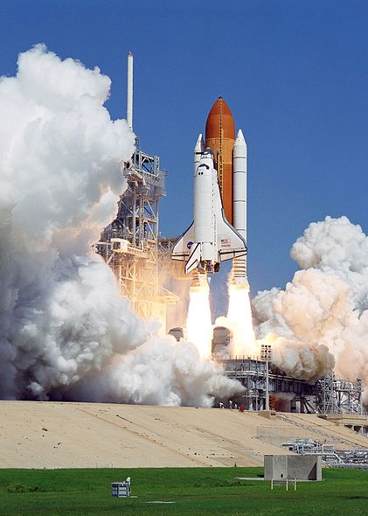
Lecture # 2 Exercise
Δv and trajectories
Propulsion subsystem design for a LEO cargo return capsule

Slide 3
Which Spacecraft can reach Moon?
Objective: To analyze performance need
The Space Shuttle – Fly me to the moon?
Would it have been possible to fly to the moon with the Space Shuttle?
Space Shuttle data
Lunar distance : 384,000 km
Shuttle Orbital Speed : 7,680 m / s
Maximum cargo mass : 28,000 kilograms
L2 – ∆v & LEO Capsule
Space Propulsion ENG-510

Slide 4

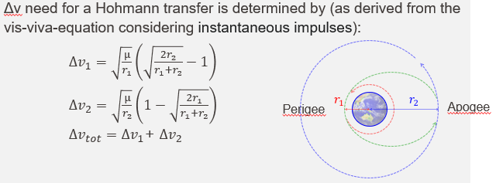
Which Spacecraft can reach Moon?
Objective: To analyze performance need
The Space Shuttle – Fly me to the moon?
The Moon is ‘located’ at an orbit speed of 1.0 km / s. What must be the Space Shuttle speed change to reach lunar orbit?
L2 – ∆v & LEO Capsule
Space Propulsion ENG-510
Δv₁ = 3.08 km / s
Δv₂ = 0.8 km / s
Δv_{tot} = 3.88 km / s

Slide 5
Which Spacecraft can reach Moon?
Objective: To analyze performance need
The Space Shuttle – Fly me to the moon?
When the Shuttle Orbital Maneuvering System (OMS) is turned on, it can cause a speed change of 0.6 m / s for every second that the engines are burning. How many seconds would the OMS have to remain on in order for the Space Shuttle to build up the necessary velocity change to reach the Moon?
L2 – ∆v & LEO Capsule
Space Propulsion ENG-510
The Δv to get to the moon is 3,880 m / s. The OMS can produce 0.6 m / s every second, so the total burn time would have to be T = 3,880 / 0.6 or about 6,467 s of continuous thrust.

Slide 6
Which Spacecraft can reach Moon?
Objective: To analyze performance need
The Space Shuttle – Fly me to the moon?
The OMS can produce a maximum Δ v of 1,000 m / s before consuming all of its 4,850 kg of fuel. How many kilograms of fuel will the OMS have to expend to get to the Moon?
L2 – ∆v & LEO Capsule
Space Propulsion ENG-510
We need a total Δv of 3,880 m / s, so 4,850 kg x (3,880 / 1,000) = 18,818 kg of fuel.

Slide 7
Which Spacecraft can reach Moon?
Objective: To analyze performance need
The Space Shuttle – Fly me to the moon?
Does the Space Shuttle have the payload capacity to carry enough extra fuel for this one-way trip?
L2 – ∆v & LEO Capsule
Space Propulsion ENG-510
The maximum cargo mass is 28,000 kg, the OMS fuel would require 18,818 / 28,000 = 0.67 times the maximum load of the Space Shuttle cargo bay, i.e. 67 % of the payload capability.

Slide 8
Which Launch Site is the best?
Objective: To get good understanding of trajectories
Which launch site would you choose and why for:
GTO mission
ISS mission
SSO mission
L2 – ∆v & LEO Capsule
Space Propulsion ENG-510

Slide 9

Which Launch Site is the best?
SSO
ISS
L2 – ∆v & LEO Capsule
Space Propulsion ENG-510
ISS
GTO

Slide 10
Which Propulsion System for LEO Capsule?
Objective: To understand propulsion system selection process
Design the propulsion subsystem for a LEO cargo return capsule
Dry mass of 10 tons
Mission duration of 6 months
L2 – ∆v & LEO Capsule
Space Propulsion ENG-510

Slide 11
Which Propulsion System for LEO Capsule?
Objective: To understand propulsion system selection process
Design the propulsion subsystem for a LEO cargo return capsule
To develop a vehicle, its associated infrastructure and operations, capable of delivering pressurized cargo to human outposts in LEO and returning cargo to Earth (basic configuration)
To execute a demonstration mission to the ISS targeting a launch date before the end of 2029
To ensure that the vehicle, its associated infrastructure and operations, are compatible with the evolutions to a crew transportation service to human outposts in LEO (evolution step 1) and to a cargo return service from Gateway in cis-lunar orbit without major modifications of the architecture (evolution step 2)
L2 – ∆v & LEO Capsule
Space Propulsion ENG-510

Slide 12
Which Propulsion System for LEO Capsule?
Objective: To understand propulsion system selection process
Main requirements (L0 – Level 0):
Maiden flight with demo to ISS before end 2029
Upload 4 ton pressurized cargo to LEO
Cargo density of 260 kg / m³
Download 2 ton pressurized cargo
Competitive price / kg on LEO market
< 75 k€ / kg for pressurized cargo upload
3.5 ton mission => 260 M€
L2 – ∆v & LEO Capsule
Space Propulsion ENG-510

Slide 13
Which Propulsion System for LEO Capsule?
Objective: To understand propulsion system selection process
Main requirements (L0 – Level 0):
Versatility / growth potential for evolution towards
LEO crewed missions (a minimum crew size of 3, a docked mission duration of 210 days and an autonomous flight duration consistent with the phasing, rendezvous, and re-entry concepts, including contingencies)
Download 2 ton cargo mission from Lunar Gateway
L2 – ∆v & LEO Capsule
Space Propulsion ENG-510

Slide 14
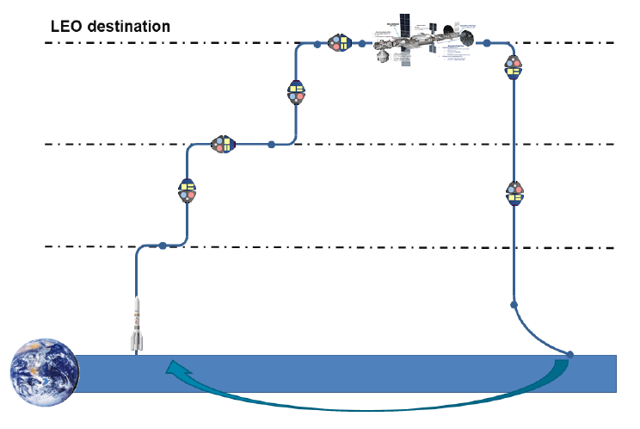
Which Propulsion System for LEO Capsule?
Docking / Un-docking
L2 – ∆v & LEO Capsule
Holding
plane
Space Propulsion ENG-510
Launcher
separation
Re-entry
Landing

Slide 15
Which Propulsion System for LEO Capsule?
Objective: To understand propulsion system selection process
Propulsion system selection (we consider launch abort system as part of launch vehicle):
Which propulsion technology might fit to LEO cargo return capsule?
Electrical propulsion
Electromagnetic acceleration (MPD thruster, pulsed plasma thruster, magnetic nozzle thruster)
Electrostatic acceleration (gridded ion thruster, hall effect thruster, field emission EP, electrospray thruster)
Electrothermal acceleration (resistojet thruster, arcjet thruster)
L2 – ∆v & LEO Capsule
Space Propulsion ENG-510

Slide 16
Which Propulsion System for LEO Capsule?
Objective: To understand propulsion system selection process
Propulsion system selection (we consider launch abort system as part of launch vehicle):
Which propulsion technology might fit to LEO cargo return capsule?
Thermal propulsion
Nuclear thermal thruster
Solar thermal thruster
Cold gas thruster
Chemical propulsion
Gaseous
Liquid
Solid
Hybrid
L2 – ∆v & LEO Capsule
Space Propulsion ENG-510

Slide 17
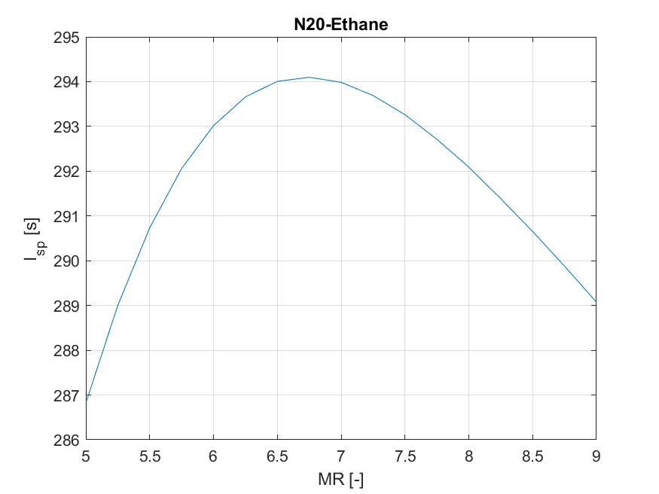
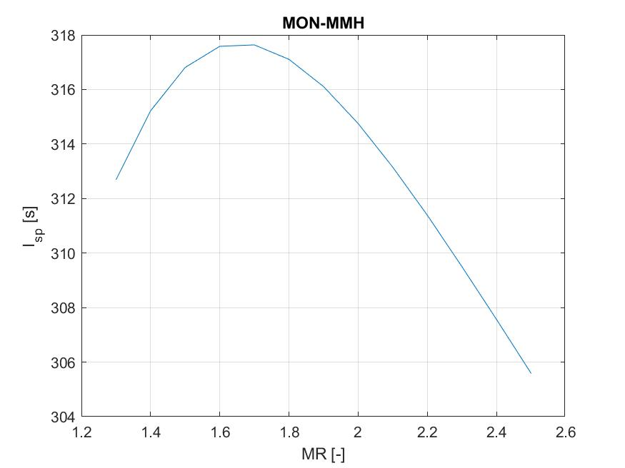
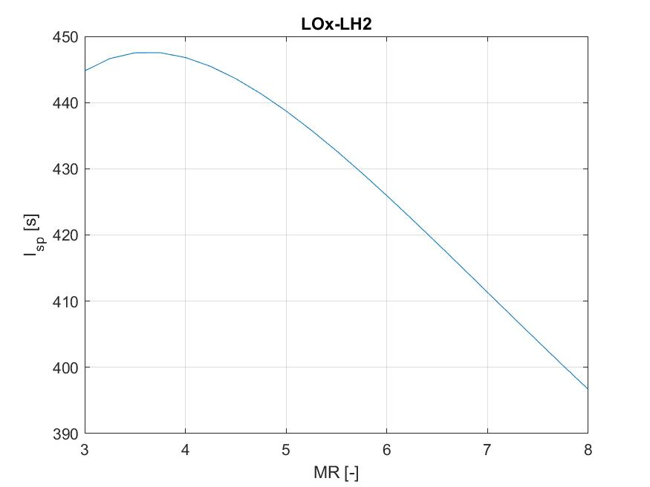
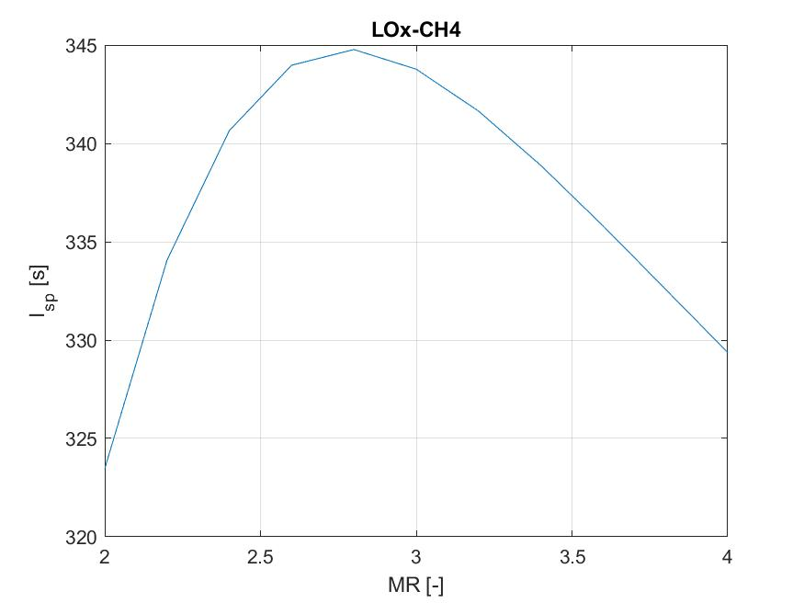
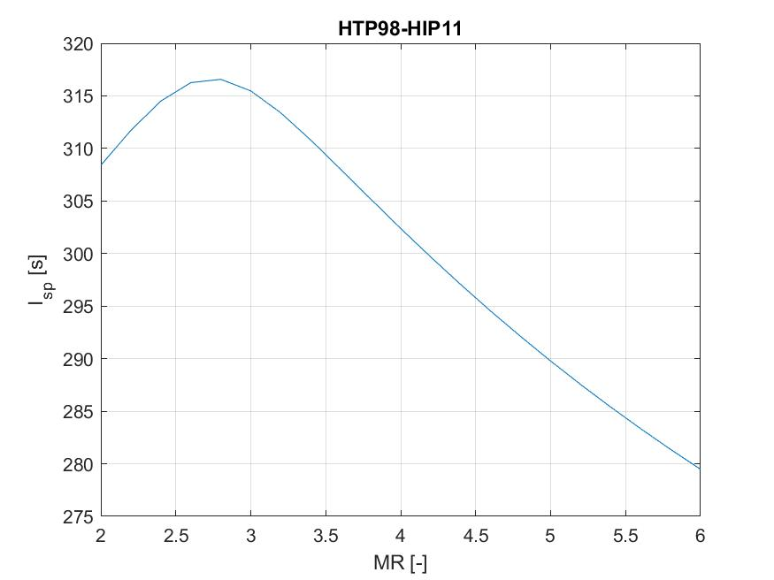
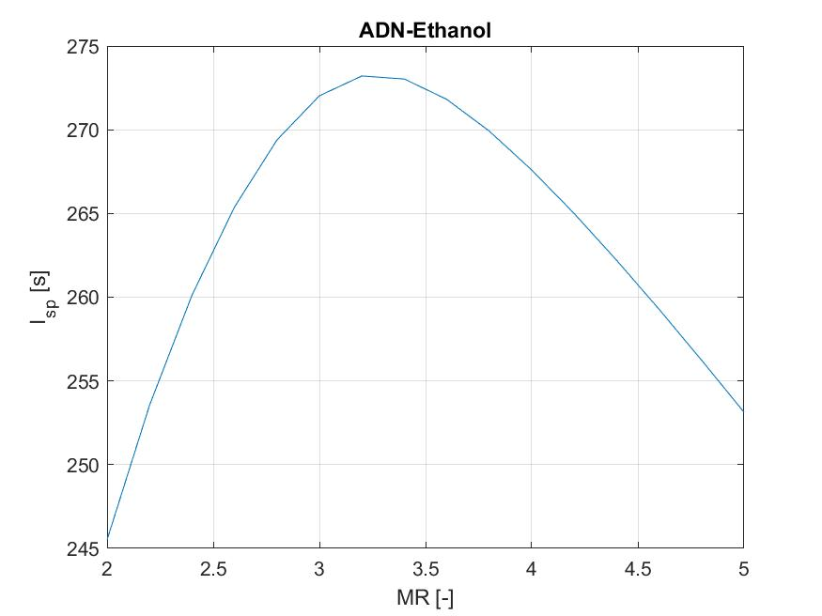
Which Propulsion System for LEO Capsule?
L2 – ∆v & LEO Capsule
Space Propulsion ENG-510

Slide 18
Lecture # 2 Back-up
Δv and trajectories
Propulsion subsystem design for a LEO cargo return capsule

Slide 19
SW 1: Spacecraft Subsystems I - Propulsion Exercise Propulsion system selection exercise: LEO cargo return capsule
Propulsion system selection:
Which propulsion technology might fit to LEO cargo return capsule?
Electrical propulsion
Electromagnetic acceleration (MPD thruster, pulsed plasma thruster, magnetic nozzle thruster)
Electrostatic acceleration (gridded ion thruster, hall effect thruster, field emission EP, electrospray thruster)
Electrothermal acceleration (resistojet thruster, arcjet thruster)
Thermal propulsion
Nuclear thermal thruster
Solar thermal thruster
Cold gas thruster
Chemical propulsion
Gaseous
Liquid
Solid
Hybrid

Slide 20
Which Propulsion System for LEO Capsule?
A
B
C
L2 – ∆v & LEO Capsule
Space Propulsion ENG-510

Slide 21
Which Propulsion System for LEO Capsule?
Objective: To understand propulsion system selection process
Design the propulsion subsystem for a LEO cargo return capsule
Dry mass of 10 tons
Mission duration of 6 months
L2 – ∆v & LEO Capsule
Space Propulsion ENG-510

Slide 22
SW 1: Spacecraft Subsystems I - Propulsion Exercise Propulsion system selection exercise: LEO cargo return capsule
Propulsion system selection:
Which propulsion technology might fit to LEO cargo return capsule?
Electrical propulsion
Electromagnetic acceleration (MPD thruster, pulsed plasma thruster, magnetic nozzle thruster)
Electrostatic acceleration (gridded ion thruster, hall effect thruster, field emission EP, electrospray thruster)
Electrothermal acceleration (resistojet thruster, arcjet thruster)
Thermal propulsion
Nuclear thermal thruster
Solar thermal thruster
Cold gas thruster
Chemical propulsion
Gaseous
Liquid
Solid
Hybrid

Slide 23
Which Propulsion System for LEO Capsule?
A
B
C
L2 – ∆v & LEO Capsule
Space Propulsion ENG-510

Slide 24
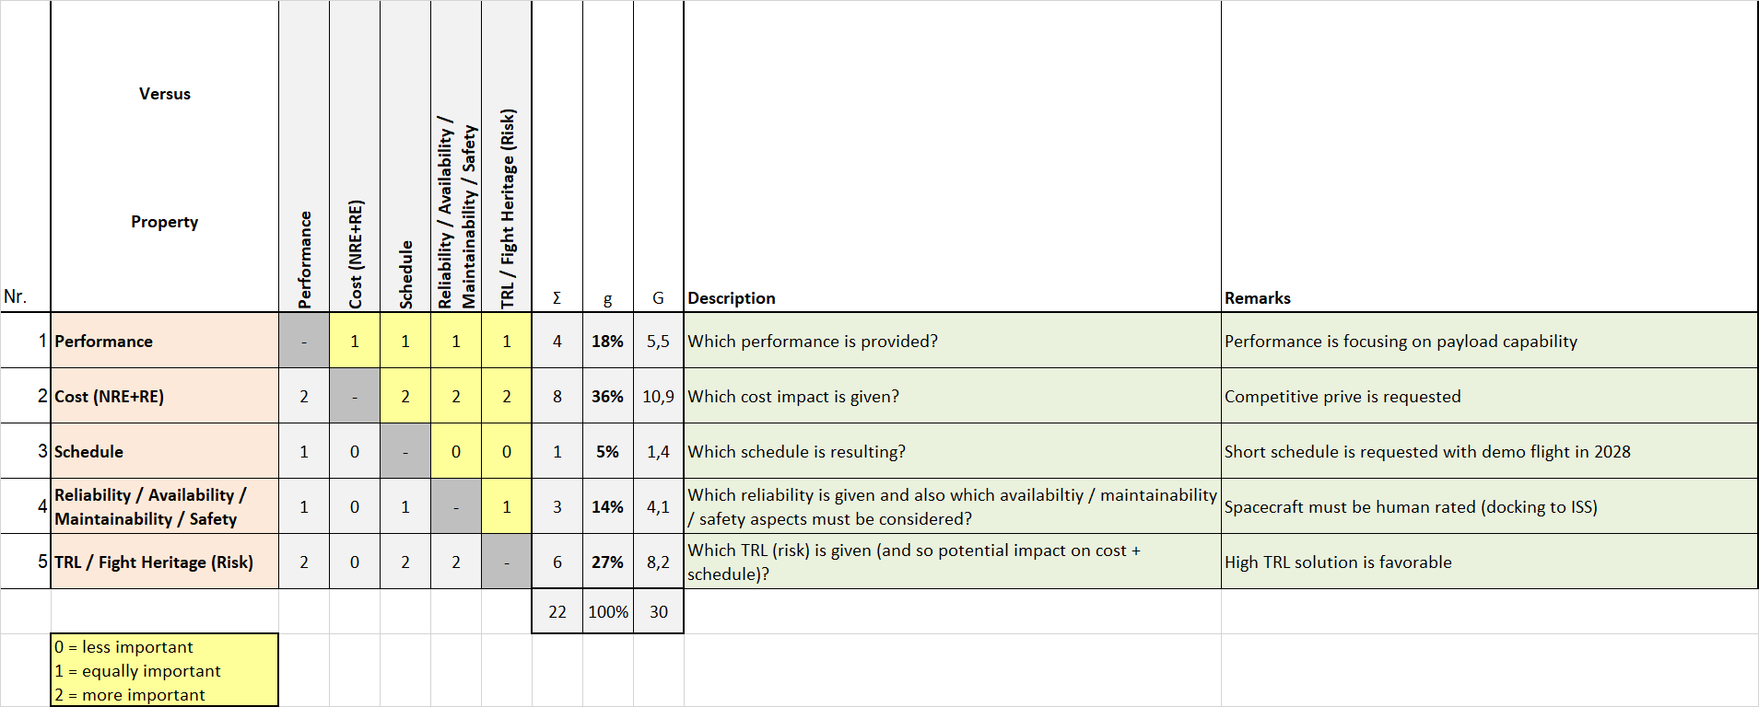
SW 1: Spacecraft Subsystems I - Propulsion Exercise Propulsion system selection exercise: LEO cargo return capsule
Propulsion system selection:
Which propulsion technology might fit to LEO cargo return capsule?
Propulsion technology trade

Slide 25
Which Propulsion System for LEO Capsule?
A
B
C
L2 – ∆v & LEO Capsule
Space Propulsion ENG-510

Slide 26
SW 1: Spacecraft Subsystems I - Propulsion Exercise Propulsion system selection exercise: LEO cargo return capsule
Propulsion system selection:
Which performance is required for LEO cargo return capsule?
Are the customer (L0) requirements sufficient?
Delta v…
Thrust…
Isp…
Delta v need is about 500 m/s for LEO cargo return capsule
Thrust need differs between attitude control and delta v maneuvers
Attitude control requires pulse mode firing with small MIB
Delta v maneuver require steady state firing with sufficient thrust
Thrust level of 20 N is good starting point for attitude control thrusters
Thrust level of 200 N is reasonable for delta v thrusters (considering 4 thrusters running in parallel)
Isp depends on propellant combination

Slide 27
Which Propulsion System for LEO Capsule?
A
B
C
L2 – ∆v & LEO Capsule
Space Propulsion ENG-510

Slide 28
SW 1: Spacecraft Subsystems I - Propulsion Exercise Propulsion system selection exercise: LEO cargo return capsule
Propulsion system selection:
Which performance is required for LEO cargo return capsule?
Isp…
Isp depends on propellant combination
Rocket CEA
Propellant data from REFPROP (computer program developed by the National Institute of Standards and Technology (NIST). NIST database contains the thermophysical data of several fluids in the gas, liquid and supercritical state which are accessible through a Python request calling the REFPROP library)

Slide 29
Which Propulsion System for LEO Capsule?
A
B
C
L2 – ∆v & LEO Capsule
Space Propulsion ENG-510

Slide 30
SW 1: Spacecraft Subsystems I - Propulsion Exercise Propulsion system selection exercise: LEO cargo return capsule
Propulsion system selection:
Which performance is required for LEO cargo return capsule?
Isp…
Isp depends on propellant combination
Rocket CEA

Slide 31
Which Propulsion System for LEO Capsule?
A
B
C
L2 – ∆v & LEO Capsule
Space Propulsion ENG-510

Slide 32
SW 1: Spacecraft Subsystems I - Propulsion Exercise Propulsion system selection exercise: LEO cargo return capsule
Propulsion system selection:
Which propulsion technology might fit to LEO cargo return capsule?
Any impact by evolution step 1? Crew of 3 on board?
Oxygen
Nitrogen
CO2 carbon dioxide
Water

Slide 33
Which Propulsion System for LEO Capsule?
A
B
C
L2 – ∆v & LEO Capsule
Space Propulsion ENG-510

Slide 34
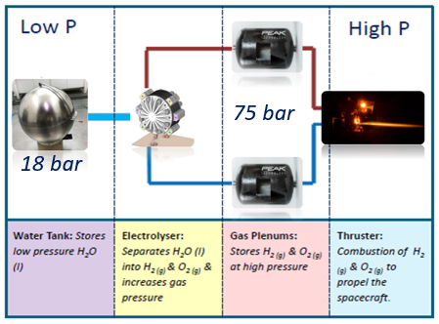
SW 1: Spacecraft Subsystems I - Propulsion Exercise Propulsion system selection exercise: LEO cargo return capsule
Propulsion system selection:
Which propulsion technology might fit to LEO cargo return capsule?
Any impact by evolution step 1? Crew of 3 on board?
Electrolyser

Slide 35
Which Propulsion System for LEO Capsule?
A
B
C
L2 – ∆v & LEO Capsule
Space Propulsion ENG-510

Slide 36
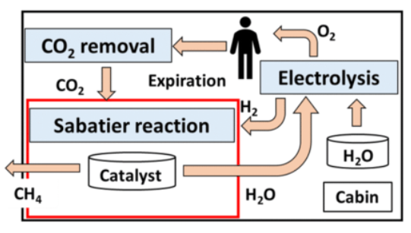
SW 1: Spacecraft Subsystems I - Propulsion Exercise Propulsion system selection exercise: LEO cargo return capsule
Propulsion system selection:
Which propulsion technology might fit to LEO cargo return capsule?
Any impact by evolution step 1? Crew of 3 on board?
Sabatier reactor

Slide 37
Which Propulsion System for LEO Capsule?
A
B
C
L2 – ∆v & LEO Capsule
Space Propulsion ENG-510

Slide 38
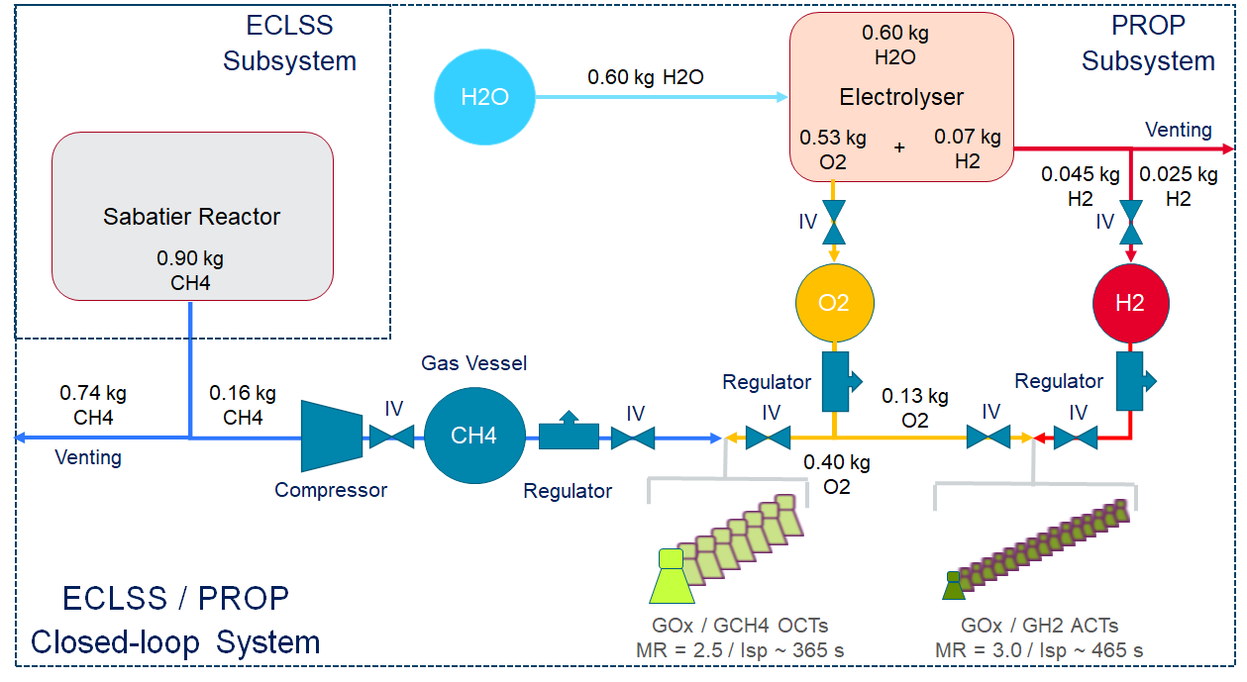
SW 1: Spacecraft Subsystems I - Propulsion Exercise Propulsion system selection exercise: LEO cargo return capsule
Propulsion system selection:
Which propulsion technology might fit to LEO cargo return capsule?
Any impact by evolution step 1? Crew of 3 on board?

Slide 39
Which Propulsion System for LEO Capsule?
A
B
C
L2 – ∆v & LEO Capsule
Space Propulsion ENG-510

Slide 40
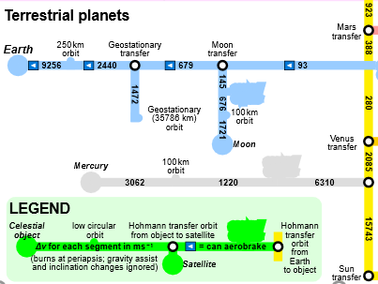
SW 1: Spacecraft Subsystems I - Propulsion Exercise Propulsion system selection exercise: LEO cargo return capsule
Propulsion system selection:
Which propulsion technology might fit to LEO cargo return capsule?
Any impact by evolution step 1? Crew of 3 on board?
Any impact by evolution step 2? Docking to Lunar Gateway?
Delta v need of 4 km / s

Slide 41
Which Propulsion System for LEO Capsule?
A
B
C
L2 – ∆v & LEO Capsule
Space Propulsion ENG-510

Slide 42
SW 1: Spacecraft Subsystems I - Propulsion Exercise Propulsion system selection exercise: LEO cargo return capsule
Propulsion system selection:
Which propulsion technology might fit to LEO cargo return capsule?
Final selection?
So this was the easy part. Let’s continue with some more difficult topics…

Slide 43
Which Propulsion System for LEO Capsule?
A
B
C
L2 – ∆v & LEO Capsule
Space Propulsion ENG-510

Slide 44
SW 1: Spacecraft Subsystems I - Propulsion Exercise Propulsion system selection exercise: LEO cargo return capsule
Propulsion system design:
Budgets?
Propellant budget
Pressurant budget
Mass budget
Power budget
Pressure budget
Temperature budget

Slide 45
Which Propulsion System for LEO Capsule?
A
B
C
L2 – ∆v & LEO Capsule
Space Propulsion ENG-510

Slide 46
SW 1: Spacecraft Subsystems I - Propulsion Exercise Propulsion system selection exercise: LEO cargo return capsule
Propulsion system design:
Functional break-down?
To provide axial thrust (delta v maneuver)
To provide orbital control (attitude control maneuver)
To load propellant
To store propellant
To feed propellant
To monitor propulsion system (pressure, temperature, …)
To operate valves
To control temperature

Slide 47
Which Propulsion System for LEO Capsule?
A
B
C
L2 – ∆v & LEO Capsule
Space Propulsion ENG-510

Slide 48
SW 1: Spacecraft Subsystems I - Propulsion Exercise Propulsion system selection exercise: LEO cargo return capsule
Propulsion system design:
Functional matrices?
Functions versus phases
Functions versus products
Function | Ground phase | Ascent phase | Orbital phase | De-orbit phase
F1 Axial thrust |  |  | X | X
F2 Orbital control |  |  | X | X
Function | Pressure vessel | Tank | Valve | Thruster
F1 Axial thrust | X | X | X | X
F2 Orbital control | X | X | X | X

Slide 49
Which Propulsion System for LEO Capsule?
A
B
C
L2 – ∆v & LEO Capsule
Space Propulsion ENG-510

Slide 50
SW 1: Spacecraft Subsystems I - Propulsion Exercise Propulsion system selection exercise: LEO cargo return capsule
Propulsion system design:
Interfaces?
Electrical interface
Mechanical interface
Thermal interface
Structural interface
Communication interface

Slide 51
Which Propulsion System for LEO Capsule?
A
B
C
L2 – ∆v & LEO Capsule
Space Propulsion ENG-510

Slide 52
SW 1: Spacecraft Subsystems I - Propulsion Exercise Propulsion system selection exercise: LEO cargo return capsule
Propulsion system design:
Requirements?
L1 System
L2 Subsystem
L3 Equipment

Slide 53
Which Propulsion System for LEO Capsule?
A
B
C
L2 – ∆v & LEO Capsule
Space Propulsion ENG-510

Slide 54
SW 1: Spacecraft Subsystems I - Propulsion Exercise Propulsion system selection exercise: LEO cargo return capsule
Propulsion system design:
Alert!
Dry mass increase of 1 ton
MBSE – Model Based System Engineering
Any changes to propulsion system selection?

Slide 55
SW 1: Spacecraft Subsystems I - Propulsion Exercise Propulsion system selection exercise: LEO cargo return capsule
Propulsion system design:
Mayday!
Did we consider RAMS / safety?
Quality control?
Configuration management?

Slide 56
SW 1: Spacecraft Subsystems I - Propulsion Exercise Equipment layout exercise: First design iteration of 200 N thruster
Assumptions:
Performance: 200 N bi-propellant thruster
Oxidizer: HTP (98 % concentrated H2O2)
Fuel: DMAZ (hypergolic with HTP with some add-ons)
Epsilon: 100
Chamber pressure: 10 bar

Slide 57
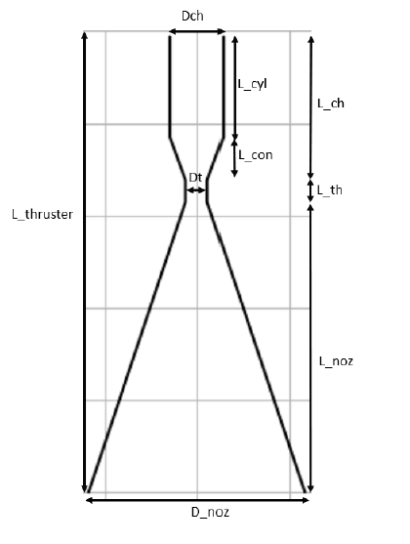
SW 1: Spacecraft Subsystems I - Propulsion Exercise Equipment layout exercise: First design iteration of 200 N thruster
Main dimensions:

Slide 58
SW 1: Spacecraft Subsystems I - Propulsion Exercise Equipment layout exercise: First design iteration of 200 N thruster
Rocket CEA:
Input
Chamber pressure (10 bar)
Mixture ratio
Nozzle area ratio so called epsilon (100)
Chemical composition assumption
Chemical reaction: Combustion frozen @ throat
Propellant data from REFPROP (computer program developed by the National Institute of Standards and Technology (NIST). NIST database contains the thermophysical data of several fluids in the gas, liquid and supercritical state which are accessible through a Python request calling the REFPROP library)
Output
Thruster vacuum specific impulse Isp
Chamber characteristic speed c*

Slide 59
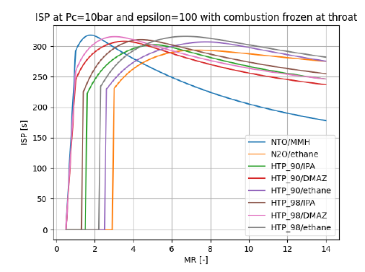
SW 1: Spacecraft Subsystems I - Propulsion Exercise Equipment layout exercise: First design iteration of 200 N thruster
Rocket CEA:
Optimal mixture ratio for HTP_98 / DMAZ?
MR = 3.0
Isp = 320 s
c* = 1687,75 m / s

Slide 60
SW 1: Spacecraft Subsystems I - Propulsion Exercise Equipment layout exercise: First design iteration of 200 N thruster
Thruster architecture:
Cooling method?
Radiative cooling
Film cooling
Regenerative cooling
Vortex cooling
Ablative cooling
Capacitive cooling
Radiative cooling or film cooling
We choose film cooling (note: radiative cooling is always given) with showerhead ingestion considering 12 orifices in axial direction

Slide 61
SW 1: Spacecraft Subsystems I - Propulsion Exercise Equipment layout exercise: First design iteration of 200 N thruster
Thruster architecture:
Cooling fluid and flow rate?
Fuel is very often used as cooling fluid
Selection depends on fluid heat capacity, mixture ratio, mass flow rate, density and oxidizer + fuel combination
In our case we choose HTP as cooling fluid due to mixture ratio and hence high HTP mass flow rate compared to DMAZ
As a starting flow rate we consider 30 % compared to nominal mass flow rate (note: This will reduce the thruster performance compared to CEA analysis results)

Slide 62

SW 1: Spacecraft Subsystems I - Propulsion Exercise Equipment layout exercise: First design iteration of 200 N thruster
Thruster design:
Mass flow rate?
$$F_{m}=\dot{m}∗g_{0}∗Isp$$
$$\dot{\dot{m}=\frac{200 N}{9,8065\frac{m}{s^{2}}∗320 s}}$$
$$\dot{\dot{m}=0,0637 \frac{kg}{s}}$$

Slide 63
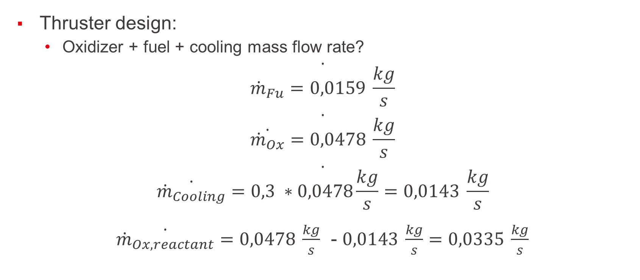
SW 1: Spacecraft Subsystems I - Propulsion Exercise Equipment layout exercise: First design iteration of 200 N thruster
Thruster design:
Oxidizer + fuel + cooling mass flow rate?
$$\dot{{\dot{m}}_{Fu}=0,0159 \frac{kg}{s}}$$
$$\dot{\dot{{\dot{m}}_{Ox}}=0,0478 \frac{kg}{s}}$$
$$\dot{\dot{{\dot{m}}_{Cooling}}=0,3 ∗0,0478\frac{kg}{s}=0,0143 \frac{kg}{s}}$$
$\dot{{\dot{m}}_{Ox,reactant}}=0,0478 \frac{kg}{s}$ - $0,0143 \frac{kg}{s}=0,0335 \frac{kg}{s}$

Slide 64

SW 1: Spacecraft Subsystems I - Propulsion Exercise Equipment layout exercise: First design iteration of 200 N thruster
Thruster design:
Throat diameter?
$$c^{∗}=\frac{p_{c}∗A_{t}}{\dot{m}}$$
$$A_{t}=\frac{c^{∗}∗\dot{m}}{p_{c}}$$
$$\dot{\dot{A_{t}=\frac{1687,75\frac{m}{s}∗0,0637 \frac{kg}{s}}{1000000\frac{N}{m^{2}}}}=0,00010751 m^{2}}$$
$$d_{t}=11,7 mm$$

Slide 65

SW 1: Spacecraft Subsystems I - Propulsion Exercise Equipment layout exercise: First design iteration of 200 N thruster
Main dimensions:
Throat length?
Throat is considered as a cylinder, with the height equal to the diameter, which enables to provide the throat length (assumption acceptable for small thrusters)
$$L_{th}=d_{t}$$
$$L_{th}=11,7 mm$$

Slide 66
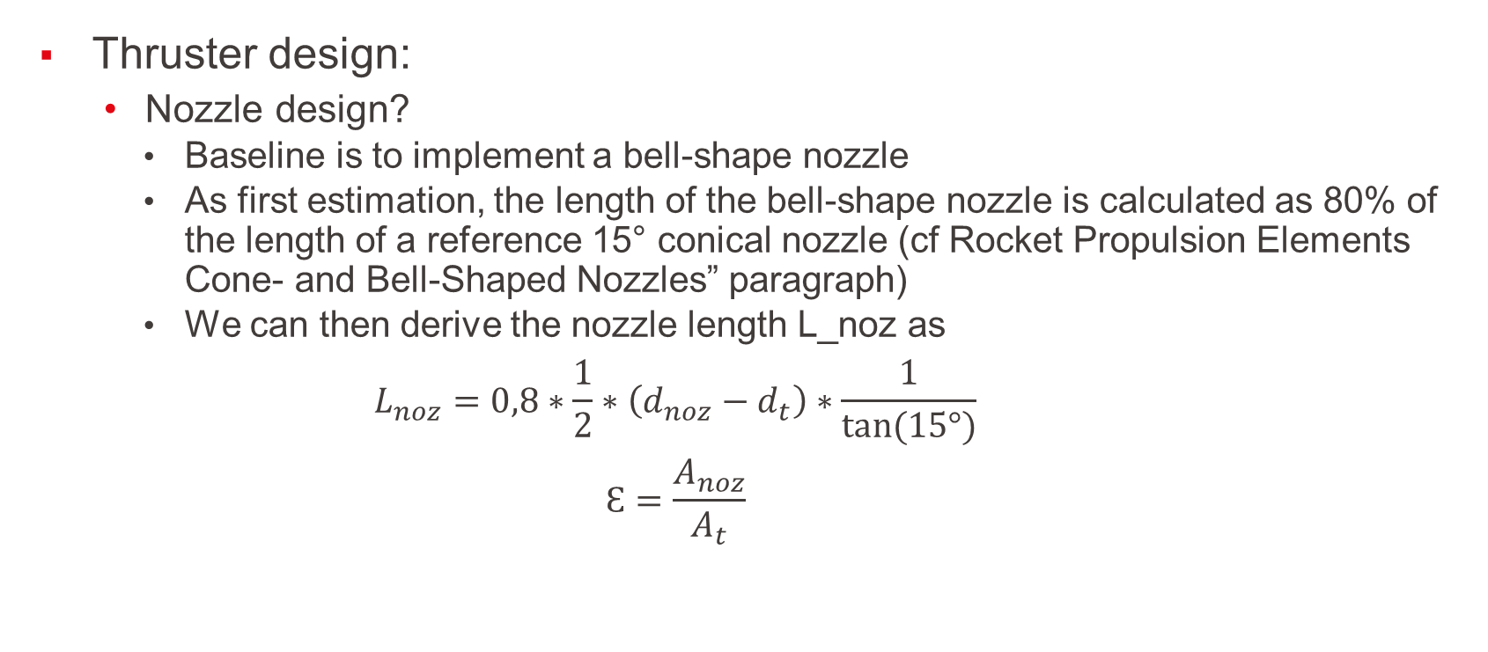
SW 1: Spacecraft Subsystems I - Propulsion Exercise Equipment layout exercise: First design iteration of 200 N thruster
Thruster design:
Nozzle design?
Baseline is to implement a bell-shape nozzle
As first estimation, the length of the bell-shape nozzle is calculated as 80% of the length of a reference 15° conical nozzle (cf Rocket Propulsion Elements Cone- and Bell-Shaped Nozzles” paragraph)
We can then derive the nozzle length L_noz as
$$L_{noz}=0,8∗\frac{1}{2}∗\left(d_{noz}−d_{t}\right)∗\frac{1}{tan⁡(15°)}$$
$$Ɛ=\frac{A_{noz}}{A_{t}}$$

Slide 67

SW 1: Spacecraft Subsystems I - Propulsion Exercise Equipment layout exercise: First design iteration of 200 N thruster
Thruster design:
Nozzle design?
Nozzle diameter
$$d_{noz}=117 mm$$
Nozzle length L_noz
$$L_{noz}=157 mm$$

Slide 68


SW 1: Spacecraft Subsystems I - Propulsion Exercise Equipment layout exercise: First design iteration of 200 N thruster
Thruster design:
Chamber dimension?
Chamber is composed of a cylindrical part and a conical part to link the cylindrical part to the throat
The cylindrical part diameter is defined with the following equation
Current baseline contraction angle is 20° (initial assumption for small thruster)
Length of the conical part L_con is defined as follows

Slide 69
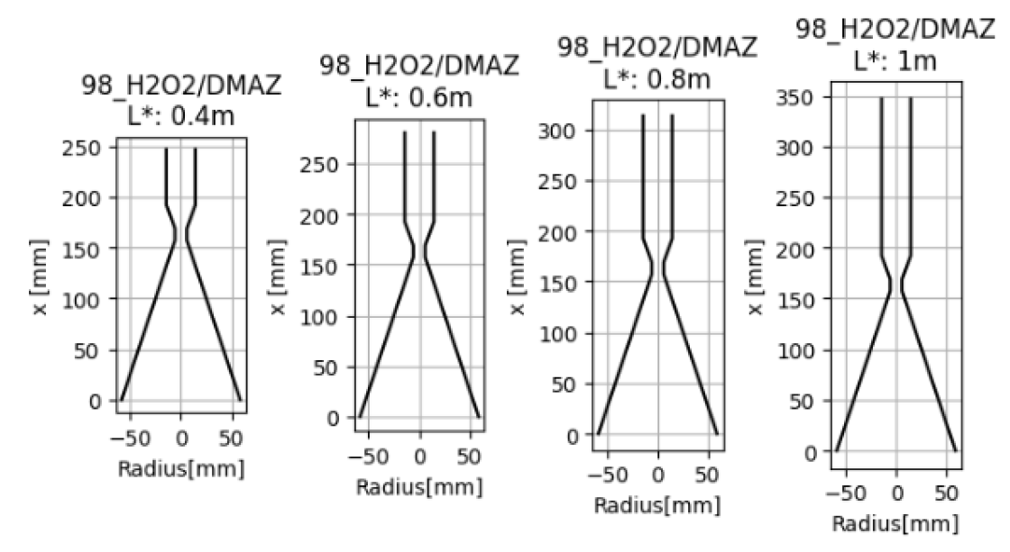
SW 1: Spacecraft Subsystems I - Propulsion Exercise Equipment layout exercise: First design iteration of 200 N thruster
Thruster design:
Chamber dimension?
Characteristic length L* / combustion efficiency
Longer combustion chamber results in higher combustion efficiency (i.e. higher performance)

Slide 70
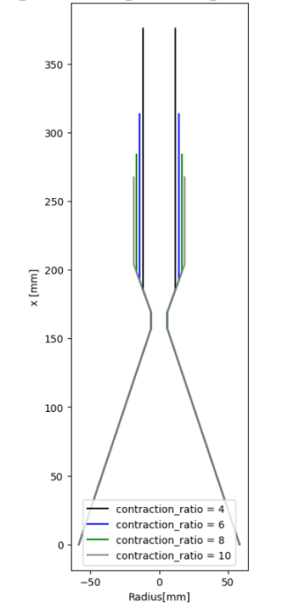
SW 1: Spacecraft Subsystems I - Propulsion Exercise Equipment layout exercise: First design iteration of 200 N thruster
Thruster design:
Chamber dimension?
Contraction ratio
For constant L*, high contraction ratio results in shorter combustion chamber length

Slide 71

SW 1: Spacecraft Subsystems I - Propulsion Exercise Equipment layout exercise: First design iteration of 200 N thruster
Thruster design:
Chamber dimension?
Contraction ratio
We choose 8
$$8=\frac{A_{chamber}}{A_{t}}$$
$$d_{chamber}=33,1 mm$$
$$L_{con}=29,4 mm$$

Slide 72


SW 1: Spacecraft Subsystems I - Propulsion Exercise Equipment layout exercise: First design iteration of 200 N thruster
Thruster design:
Chamber dimension?
Characteristic length
We choose L* = 0.8 m
Combustion chamber cylindrical part length:
$$8=\frac{A_{chamber}}{A_{t}}$$
$$L_{cyl}=85,9 mm$$

Slide 73

SW 1: Spacecraft Subsystems I - Propulsion Exercise Equipment layout exercise: First design iteration of 200 N thruster
Thruster design:
Chamber length?
$$L_{ch}=29,4 mm+85,9 mm=115,3 mm$$

Slide 74

SW 1: Spacecraft Subsystems I - Propulsion Exercise Equipment layout exercise: First design iteration of 200 N thruster
Thruster design:
Thruster length?
$$L_{thruster}=115,3 mm+157 mm+11,7 mm=284 mm$$

Slide 75
SW 1: Spacecraft Subsystems I - Propulsion Exercise Equipment layout exercise: First design iteration of 200 N thruster
Thruster design:
Injection method?
Is partially depending on ignition type
Ignition of propellants
Hypergolic ignition
Catalytic decomposition
Thermal decomposition (e.g. hot gas, thermal wire, …)
Spark plug
Glow plug
Laser ignitor
Resonance acoustic ignition
…
Torch ignitor (Different propellant or same propellants with smaller amount)
For HTP / DMAZ propellant combination hypergolic ignition is given

Slide 76
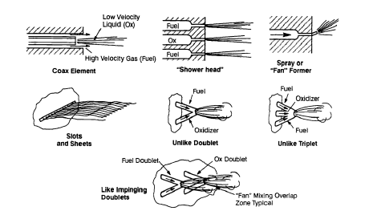
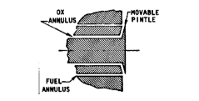
SW 1: Spacecraft Subsystems I - Propulsion Exercise Equipment layout exercise: First design iteration of 200 N thruster
Thruster design:
Injection method?
Injection method for propellants
Impingement
Concentric / coaxial tube (with or without swirl)
Splash plate
Showerhead
Pintle injector

Slide 77
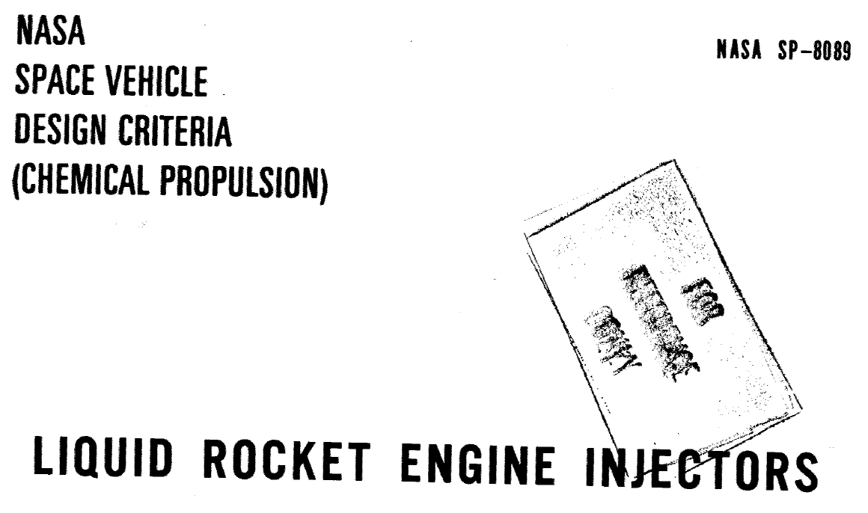
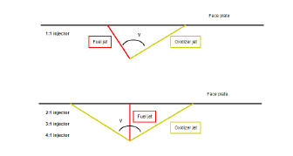
SW 1: Spacecraft Subsystems I - Propulsion Exercise Equipment layout exercise: First design iteration of 200 N thruster
Thruster design:
Injection method?
Impingement method w.r.t. hypergolic propellants as they are well studied
Unlike or like impingement?
Like impinging is first impinging of all fuel flows and all oxidizer flows and subsequently mixing of fuel and oxidizer
Unlike impinging is direct impinging of fuel flows and oxidizer flows
Unlike impingement
2 on 1 unlike impingement for 200 N thruster

Slide 78

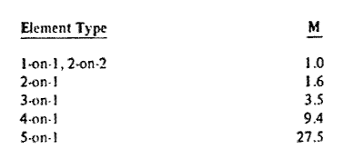
SW 1: Spacecraft Subsystems I - Propulsion Exercise Equipment layout exercise: First design iteration of 200 N thruster
Thruster design:
Injector design?
To size the orifice diameter, a correlation for the orifice ratio which maximizes the mixing efficiency is commonly used
This correlation calculates the product of the velocity-head ratio and diameter ratio of the two streams based on experimental data

Slide 79
SW 1: Spacecraft Subsystems I - Propulsion Exercise Equipment layout exercise: First design iteration of 200 N thruster
Thruster design:
Injector design?
Following constraints + steps need to be considered:
Constraint # 1: One of the constraints to consider when 3D printing elements is the maximum angle printable (above an angle of 45°, post-processing is required to manufacture the part)
Input parameter: The mass flow rate is fixed to provide a 200 N thrust
Orifice size: To increase the fuel orifice size and facilitate manufacturability, the pressure drop for the fuel and oxidizer orifices is fixed at 0.5 bars (smallest orifice size manufacturable is fixed at 0.4 mm diameter with post-processing to ensure a good surface finishing)
For a triplet (2 on 1), the most uniform mixture ratio distribution is obtained when the product of the velocity-head ratio and diameter ratio of the two streams is equal to 1.6
Therefore, the fuel orifices diameter is first estimated and based on this value, the oxidizer orifice size is calculated to optimize the velocity-head ratio product
Injection angle: The injection angles are estimated considering a resultant momentum angle null

Slide 80
SW 1: Spacecraft Subsystems I - Propulsion Exercise Equipment layout exercise: First design iteration of 200 N thruster
Thruster design:
Injector design?
Following constraints + steps need to be considered:
Orifice length: The orifice length should have a value above 15 times the orifice diameter according to NASA
Free stream length: For the hypergolic injector, the fuel Lfs ratio is fixed to 10 which imposes the oxidizer Lfs ratio

Slide 81
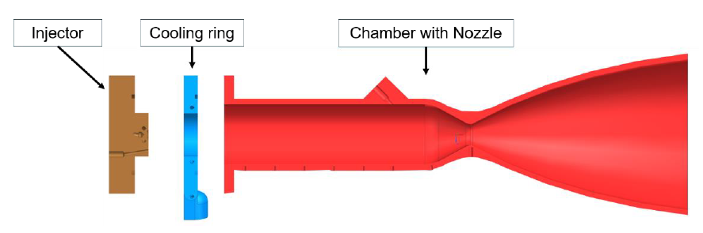
SW 1: Spacecraft Subsystems I - Propulsion Exercise
Equipment layout exercise: First design iteration of 200 N thruster

Slide 82
SW 1: Spacecraft Subsystems I - Propulsion Exercise
Equipment layout exercise: First design iteration of 200 N thruster
Ready for 3D printing (choosing good material) +
respecting post manufacturing inspection / cleaning

Slide 83
What do we know on Teammates?
Objective: What do we know on Teammates
What would be the most audacious thing that you have every done? Parachute jump
What song could you sing? Never ask me to sing!
What is your favorite holiday destination? Bicycle trips in the Alpes
If you could interview anyone famous (dead or alive, real or fiction) who would that be? No interest
What person has influenced you the most? Apart from my parents it is Richard Nerurkar who initiated my interest in running
L1 – Personalities & Icebreaker
Space Propulsion ENG-510

